Slide 1
Celebrating Success is an SIA Program
SNR 1st Place Winners for each Category
SIA Federation Judging
Winners announced at Governor’s Round Table in June
IN HONOR OF EXCELLENCE
Notes:
Celebrating Success - This SIA award honors those clubs that further the Soroptimist mission of improving the lives of women and girls.
Point out the forwarding of winners to SIA etc.
Best practice for each category as outlined by SIA. Best practice being the most effective way to achieve desired results.

Slide 2
Categories:
Fundraising
Membership
Program
Public Awareness
Applications are due on July 1 every year!!
IN HONOR OF EXCELLENCE
Notes:
I want to thank all those in our region that applied for this award. We had 9=fundraising; 2=membership; 9=program; 2=public awareness.

Slide 3
Fundraising SI Elk Grove Martinis and Merriment

Slide 4
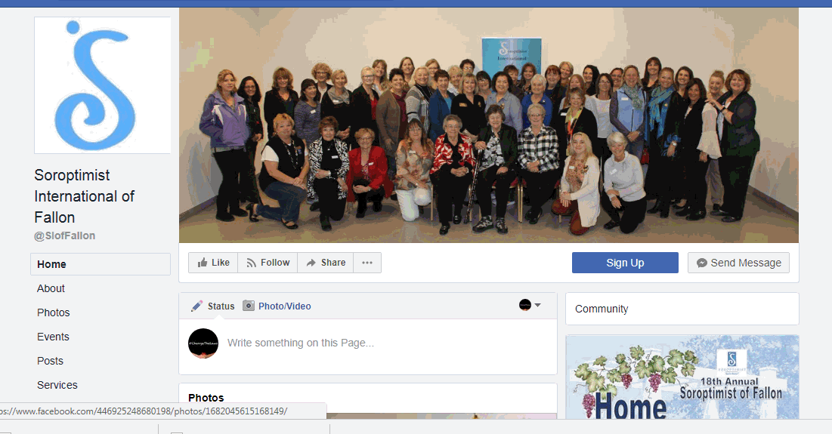
Membership SI Fallon

Slide 5
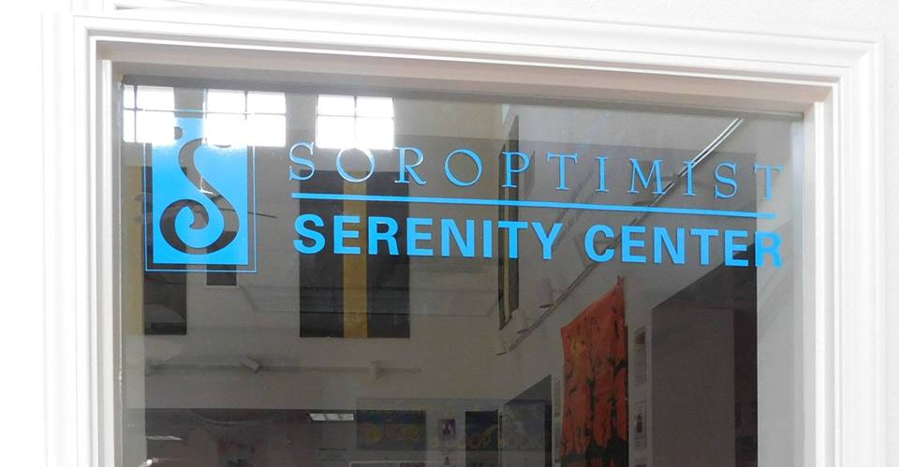
Program SI Chico Serenity Room

Slide 6
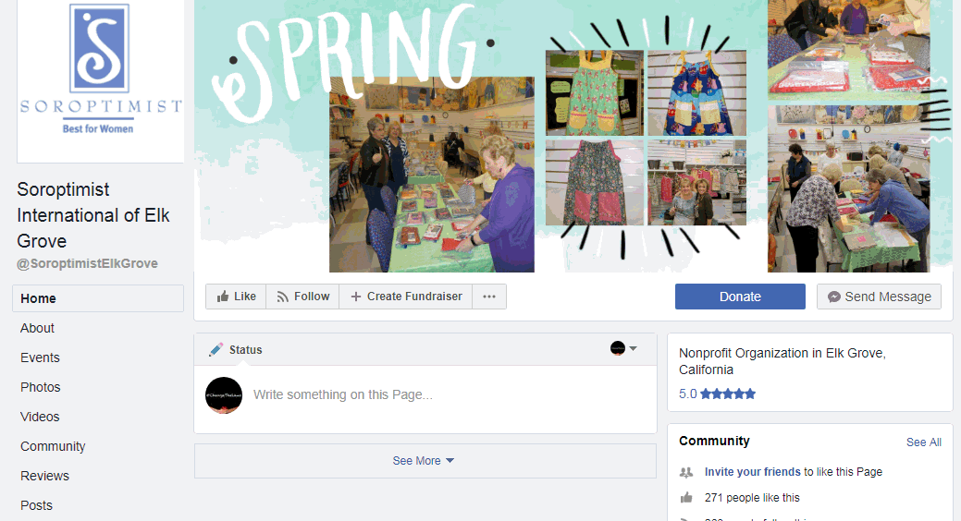
Public Awareness SI Elk Grove

Slide 7
Congratulations!!
IN HONOR OF EXCELLENCE
Notes:
I encourage clubs to reach out to our winners and “borrow” their ideas to improve your efforts in regards to program, membership, fundraising, and public awareness. Thanks to all that applied and congratulations to our winners!

Slide 8
Thank you Celebrating Success Committee!!

