Slide 1
5 Star Public Awareness Award
2018 Winner met the following criteria:
Must have entered in all four categories
Innovation
Newsletter
Website
Social Media

Slide 2
Innovation Star Award
2018 Winner met the following criteria:
Innovative use of marketing or advertising
Multiple uses of marketing or advertising
Novelty of ideas
Proof of usefulness

Slide 3
Innovation Star Award
Six total entries!
3rd Place: SI Tahoe Sierra
2nd Place: SI Bidwell Rancho
and …

Slide 4
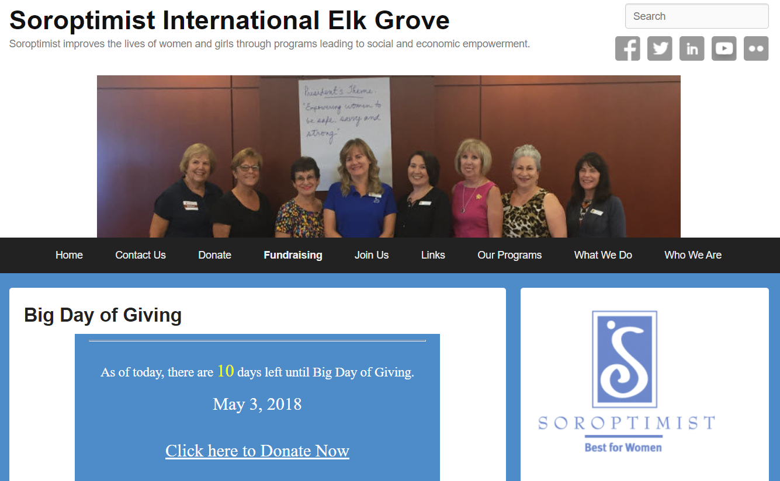
Innovation Star Award
2018 Winner:
SI of
Elk Grove

Slide 5
Newsletter Star Award
2018 Winner met the following criteria:
Clear and Simple Design
Consistent Look
Organized
Use of Soroptimist Logo and Tagline
Links to Region and SIA

Slide 6
Newsletter Star Award
Nine total entries!
3rd Place: SI Carson City
2nd Place: SI Greater Sacramento
and …

Slide 7
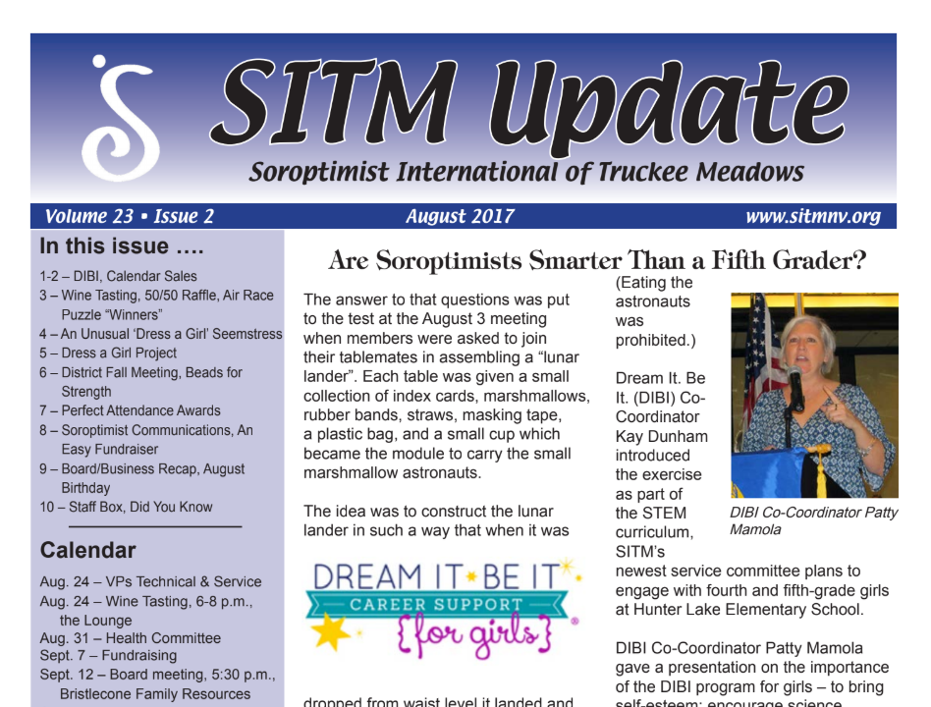
Newsletter Star Award
2018 Winner:
SI of
Truckee Meadows

Slide 8
Website Star Award
2018 Winner met the following criteria:
Clear and Simple Design
Consistent Look
Navigation Bar on All Pages
Organized
Use of Soroptimist Logo and Tagline
Links to Region and SIA
Viewable on all major Browsers and Mobile

Slide 9
Website Star Award
Twelve total entries!
3rd Place: SI Truckee Donner
2nd Place: SI Bidwell Rancho
and …

Slide 10
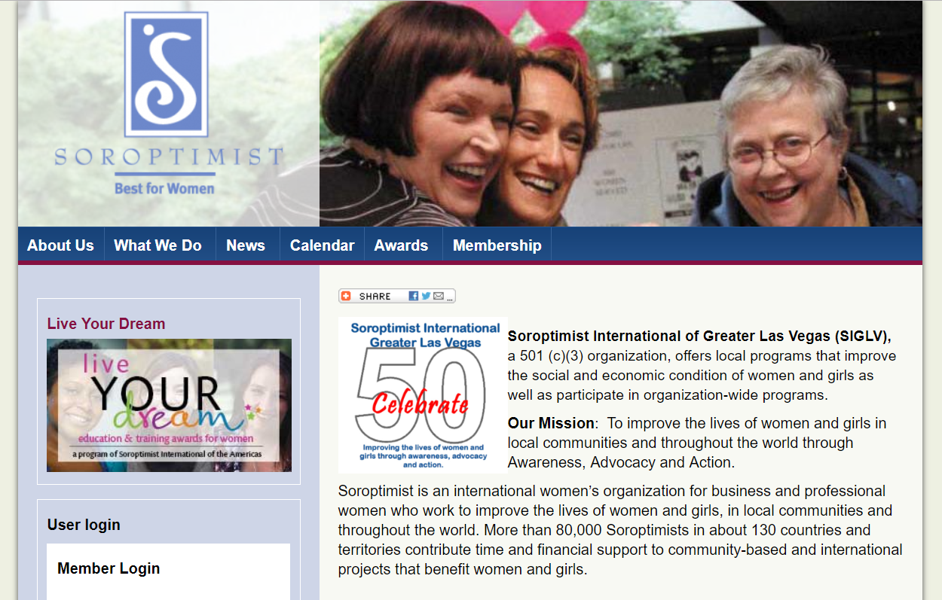
Website Star Award
2018 Winner:
SI of
Greater Las Vegas

Slide 11
Social Media Star Award
2018 Winner met the following criteria:
Prominent use of S logo
Photos of fun events and happy members
Use of Events
Sharing/Invitations from members
Organization/monitoring/security
About section
Overall look and feel

Slide 12
Social Media Star Award
Ten total entries!
3rd Place: SI Truckee Donner
2nd Place: SI Bidwell Rancho
and …

Slide 13
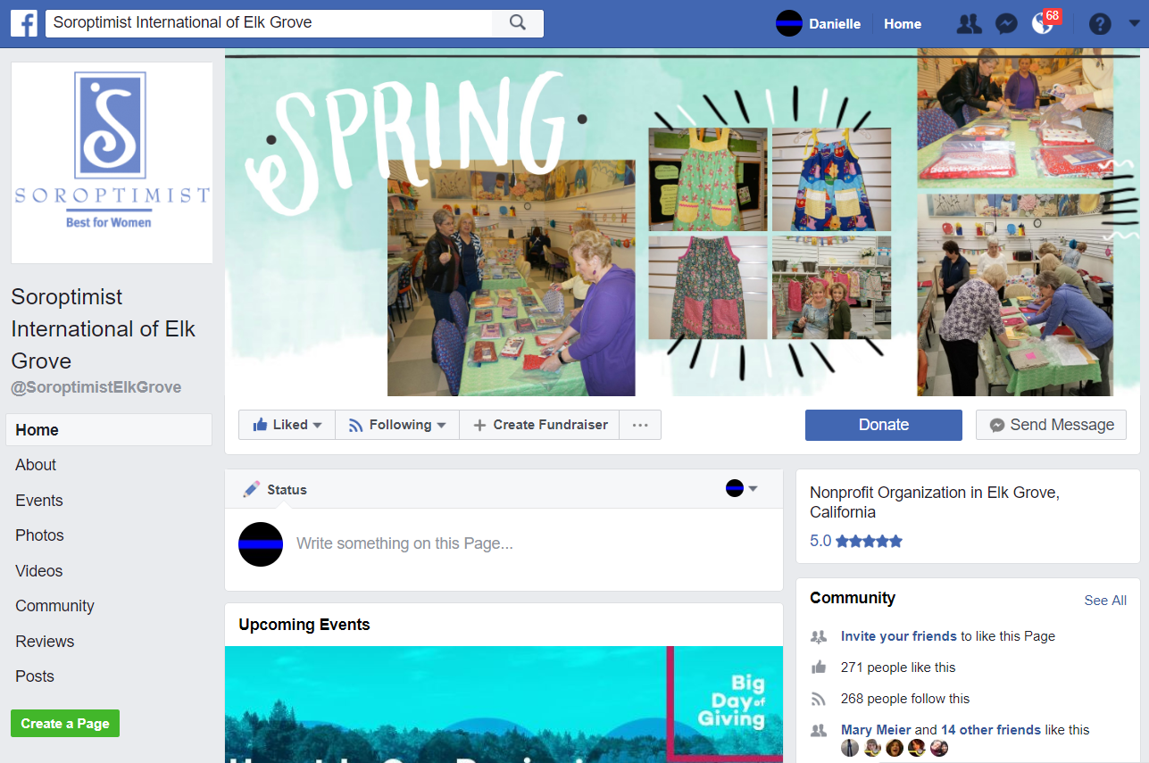
Social Media Star Award
2018 Winner:
SI of
Elk Grove

Slide 14
5 Star Award for Best Overall Public Awareness
Must have entered in all four categories
Social Media
Newsletter
Website
Innovation
Winners chosen by overall placement

Slide 15
5 Star Award for Best Overall Public Awareness
Five qualified entries!
3rd Place: SI Truckee Donner
2nd Place: SI Chico
and …

Slide 16
5 Star Award for Best Overall Public Awareness
2018 Winner:
SI of
Elk Grove

