Slide 1
SNR Report 2018 Anti Trafficking Update
Presented by Joanne Tremelling,
Northern California Anti-Trafficking Coordinator

Slide 2
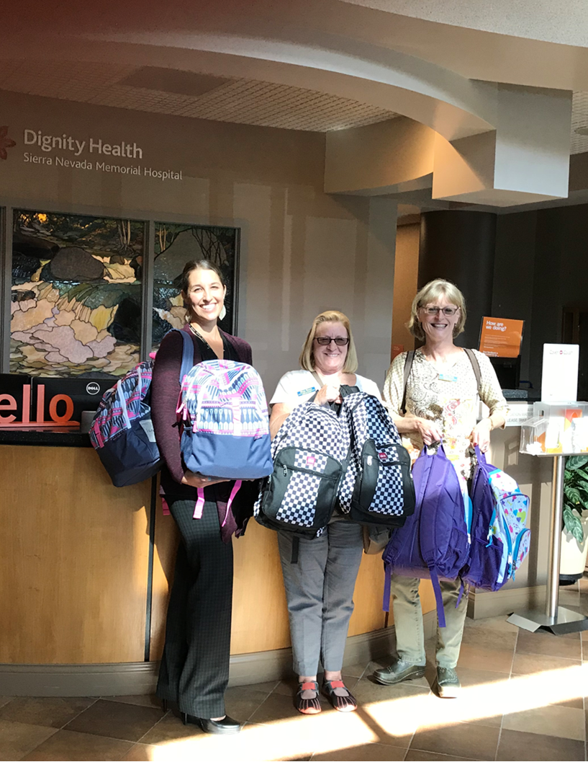

Slide 3
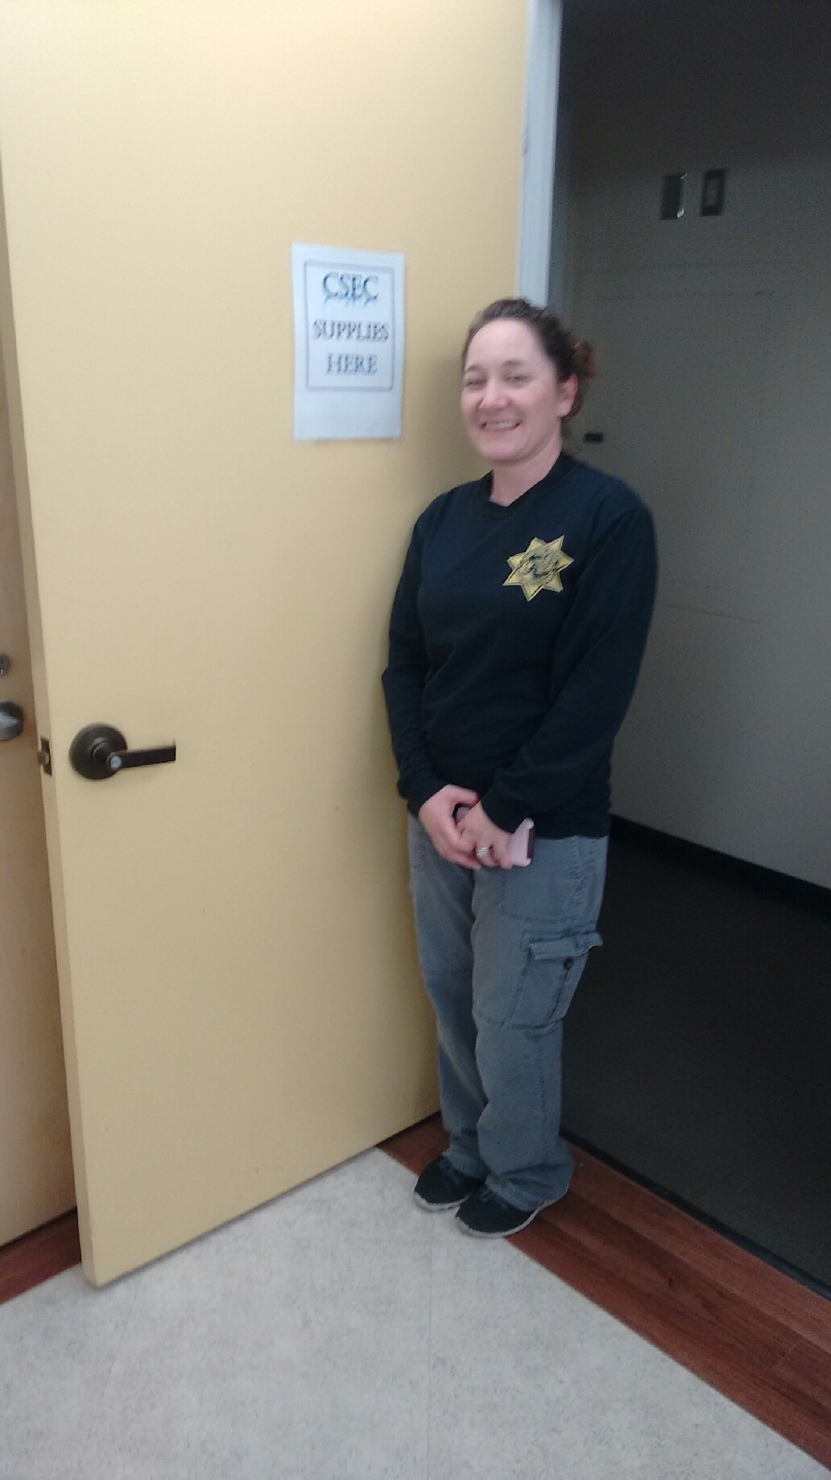

Slide 4
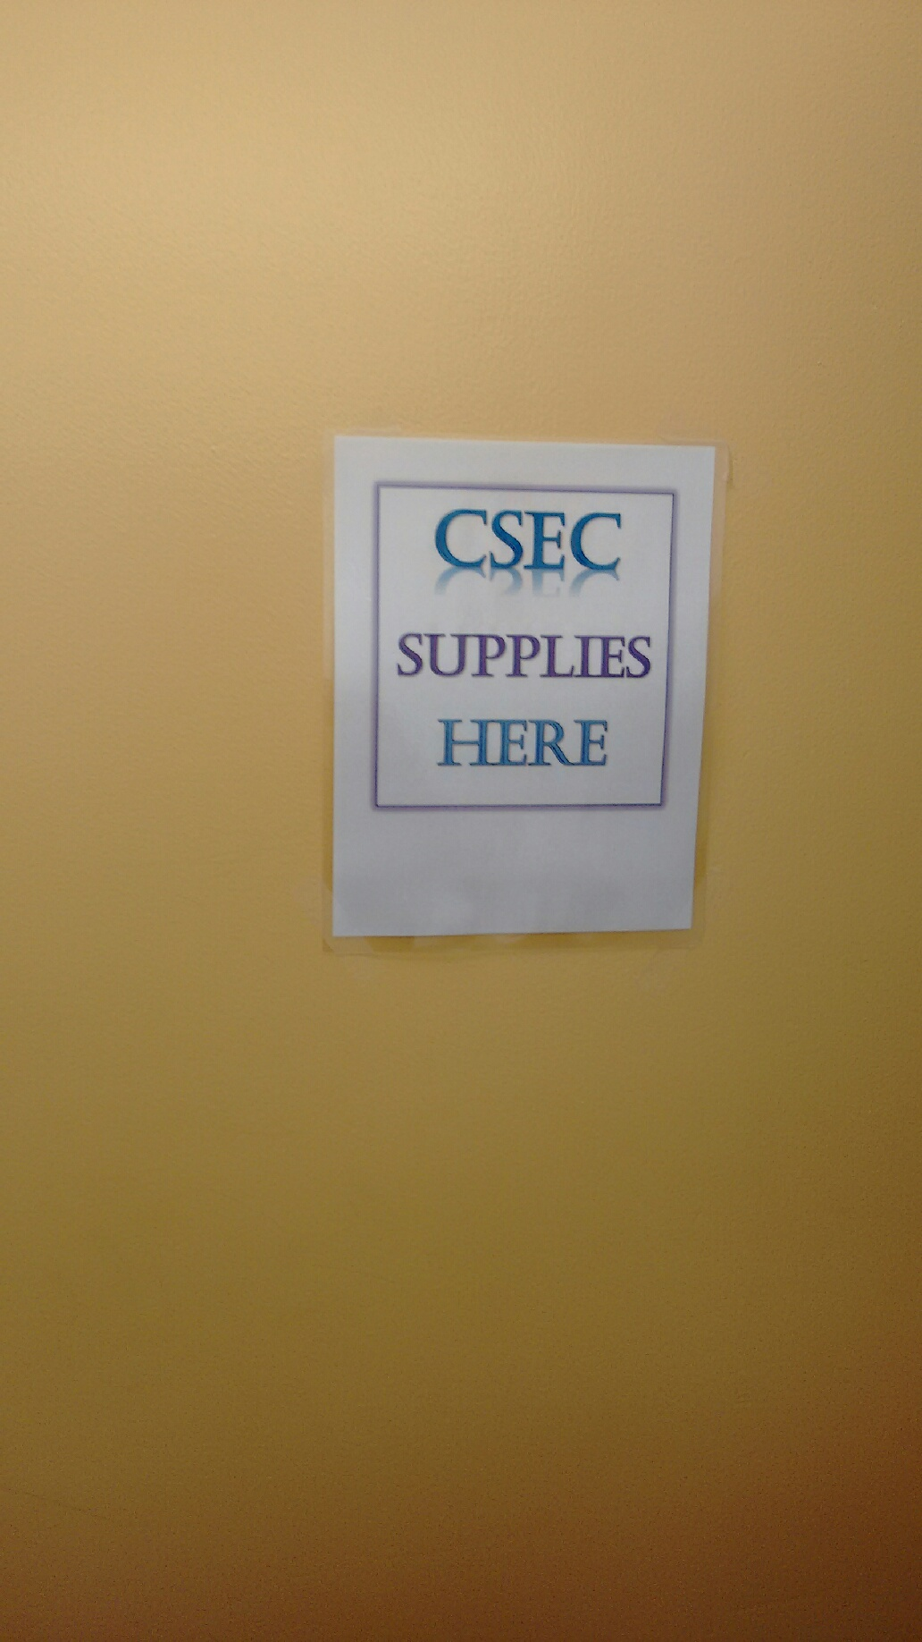

Slide 5
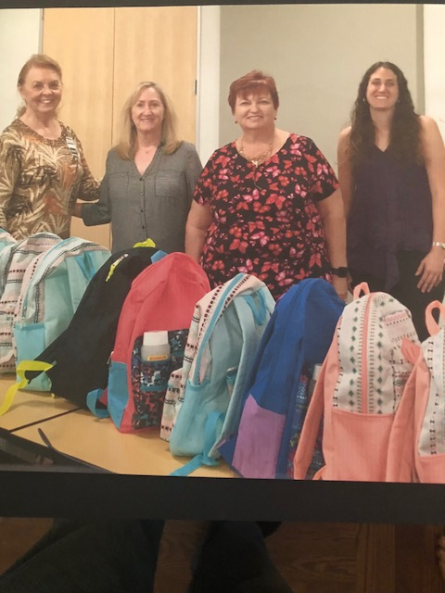

Slide 6
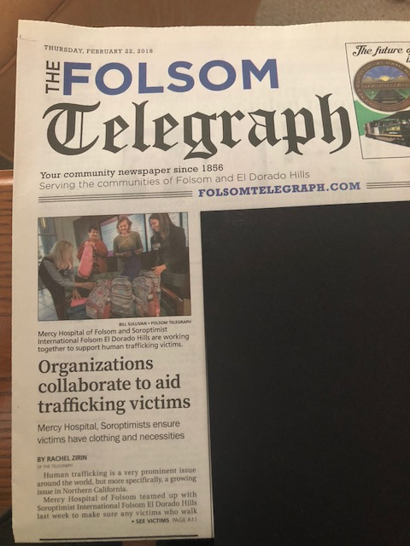

Slide 7
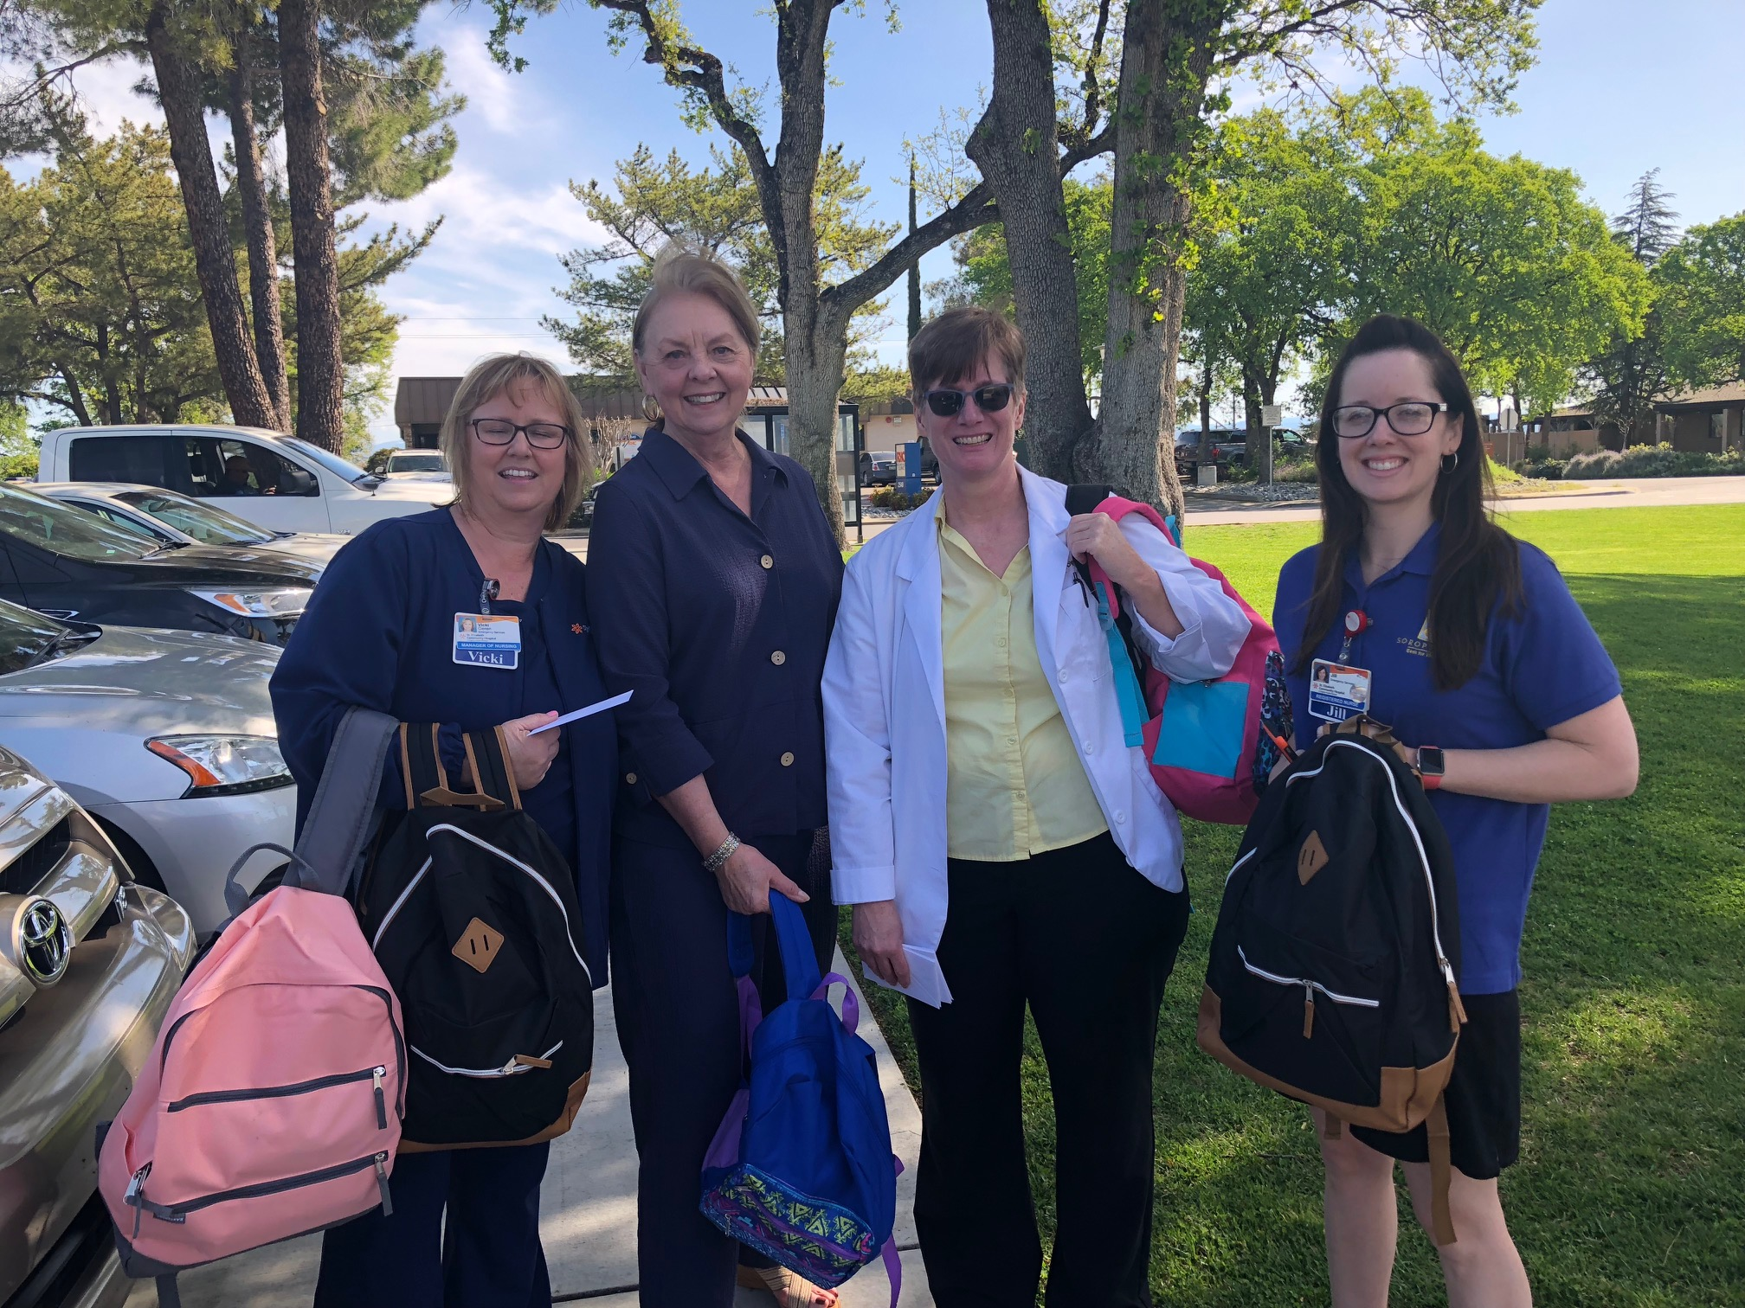

Slide 8
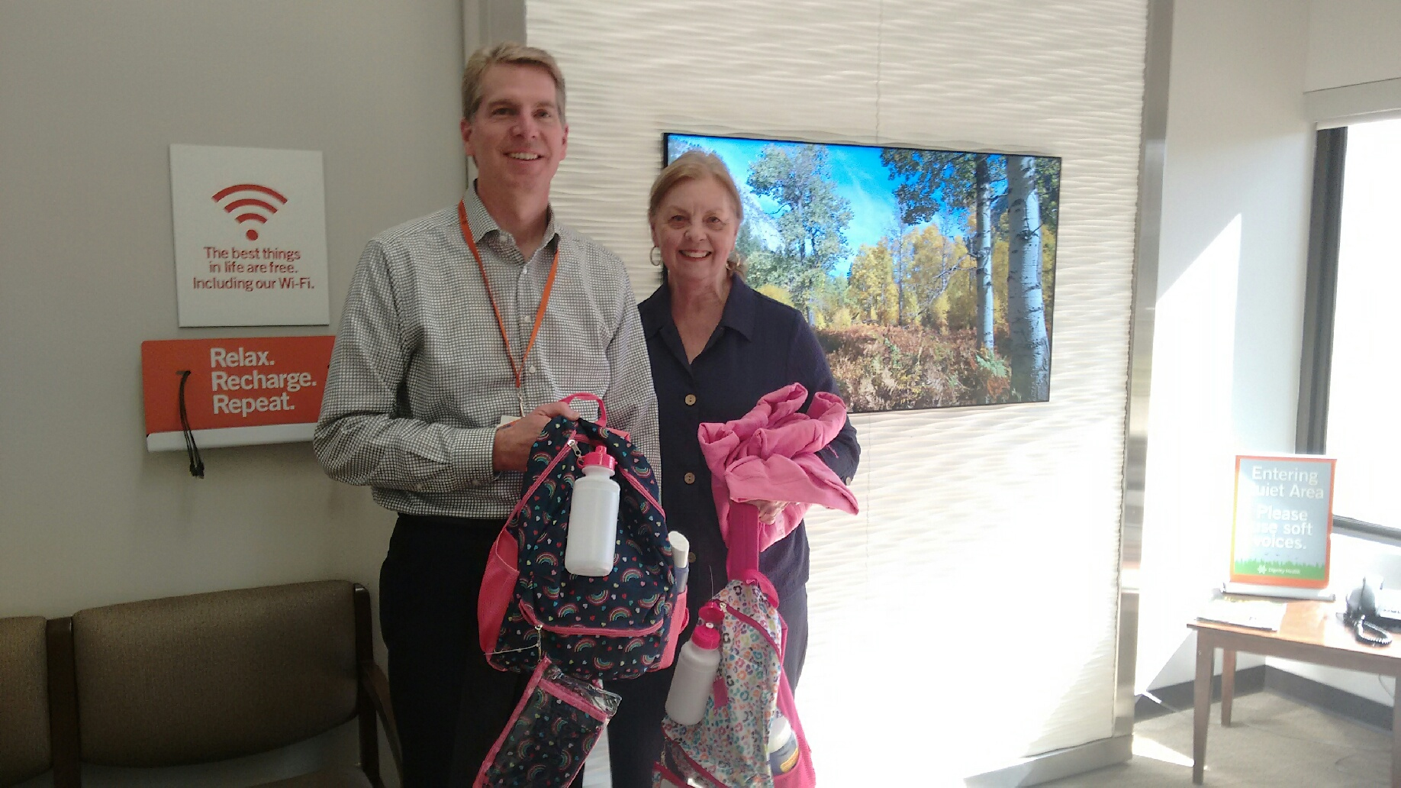

Slide 10
