Slide 1
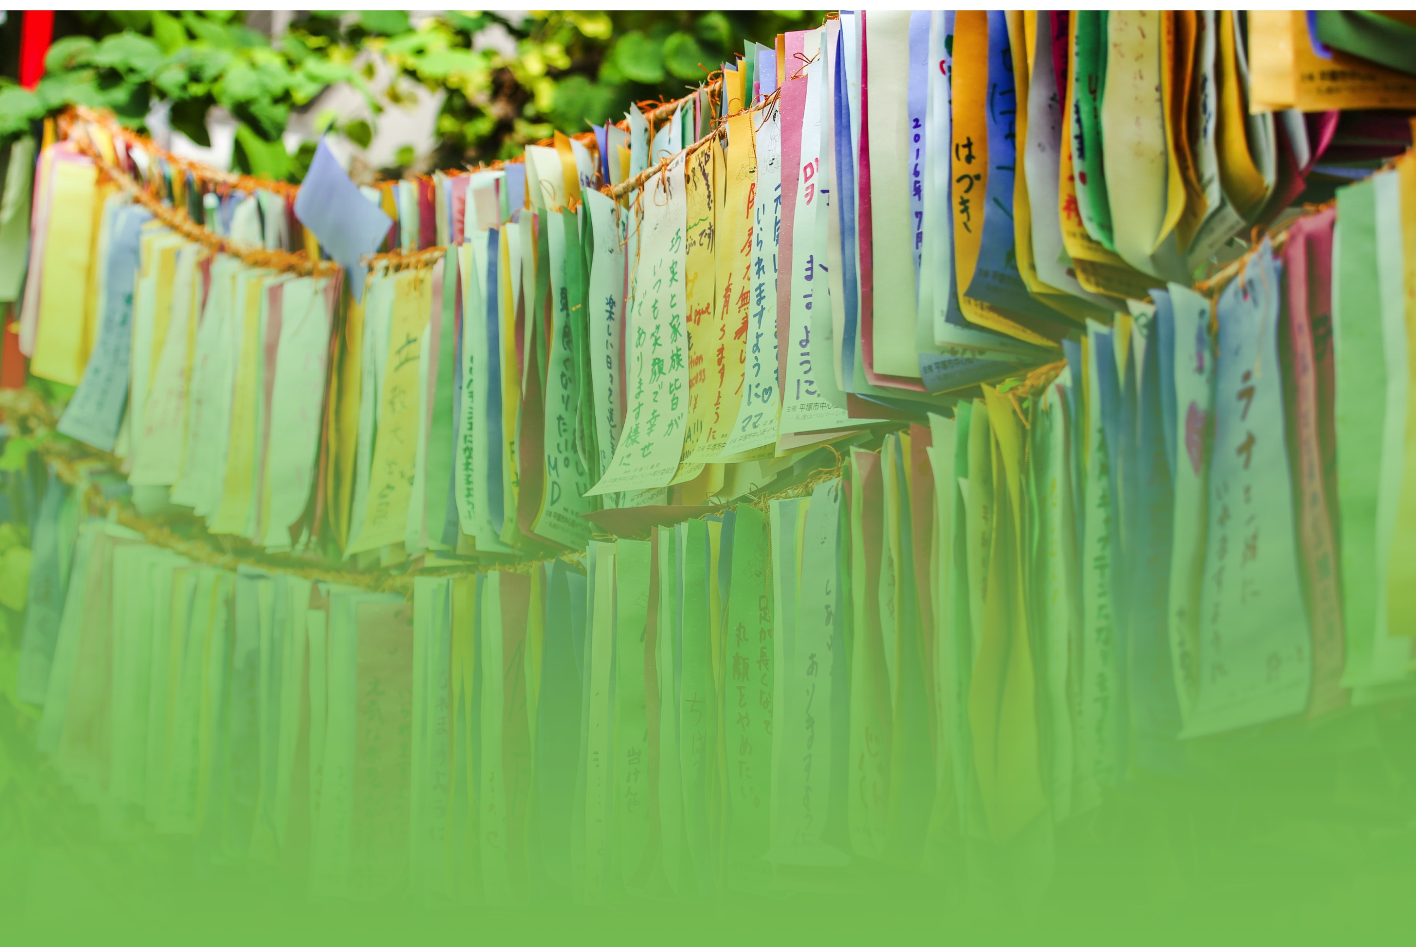

SOROPTIMIST INTERNATIONAL OF THE AMERICAS
Yokohama, Japan • July 30-August 2, 2018

